Slide 1

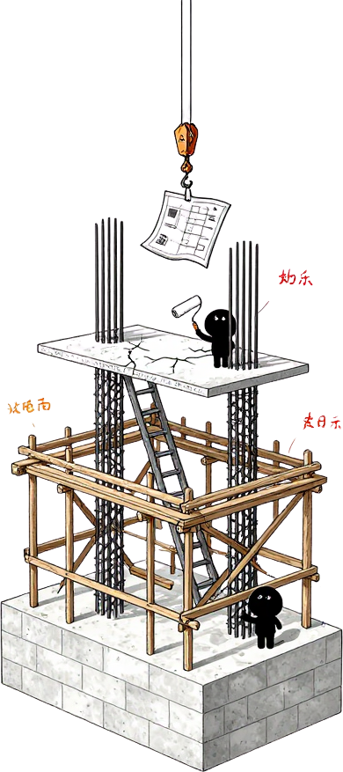









Presented By:
Ian Xiaohei
Status Checkpoint
Project Mindmap: Personal Multi-Agent Orchestration System
Development Status & Structural Checkpoint

Slide 2



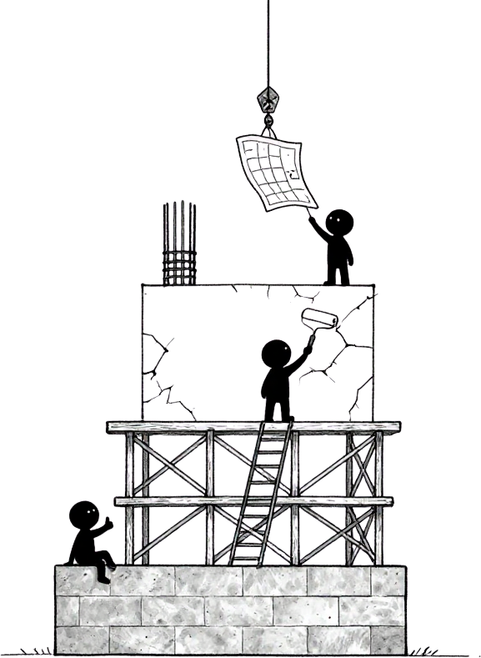





Multi-Agent System
Bottom Tier — DONE ✓
Core Platform & SQLite/Prisma Data Layer · Tasks Center & WhatsApp Ingestion · Agent Guardrails & Skills Library · Memory Vault & Stable Runtime RAG
Middle Tier — POLISH ⚙
Dashboard Executive Layout Refinement · Final Reply Quality (fixing "Draft" fragments) · Retrieval Lab UX & Maintenance Progress Metrics
Top Tier — NEXT ROADMAP ↑
3D Agent Office & Visual Workspace · Dynamic Routing & Collaboration Flows · Advanced Knowledge Graph Analytics
Future Horizon — VISION ◇
Multi-provider Cost & Latency Tracking · Autonomous Agent Collaboration · Self-optimizing Orchestration Pipelines

Slide 3







Thank You
Development Status Checkpoint Complete
Personal Multi-Agent Orchestration System
Structural Checkpoint · 2024
Built with clarity. Ready for the next tier.

